Slide 1


IoT Data Collection and Monitoring System
An IoT project that collects sensor data, transmits it over MQTT, and processes it on a Raspberry Pi. Integrates with AWS EC2 for global access and web interface.

Slide 2
Hardware Components
ESP32 Microcontroller
Raspberry Pi
AWS EC2 Instance
Collects sensor data and transmits it over MQTT
Receives MQTT data, stores in database, and powers web interface
Hosts web application for global access and monitoring

Slide 3
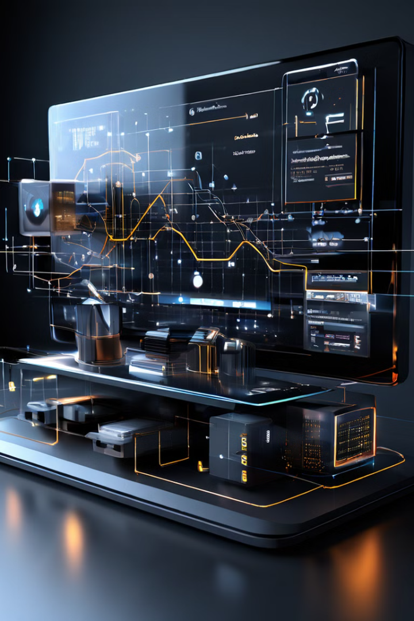
Data Collection and Transmission
1
Sensor Data
ESP32 reads from temperature, humidity, and motion sensors
2
MQTT Messaging
ESP32 publishes sensor data to MQTT broker
3
Raspberry Pi Subscriber
Raspberry Pi subscribes to MQTT topics and receives data

Slide 4
Data Processing and Storage
MariaDB Database
Data Aggregation
On-Demand Retrieval
Raspberry Pi stores last 30 days of sensor data in database
Raspberry Pi processes raw sensor data and calculates averages
Web interface allows users to view historical sensor data

Slide 5
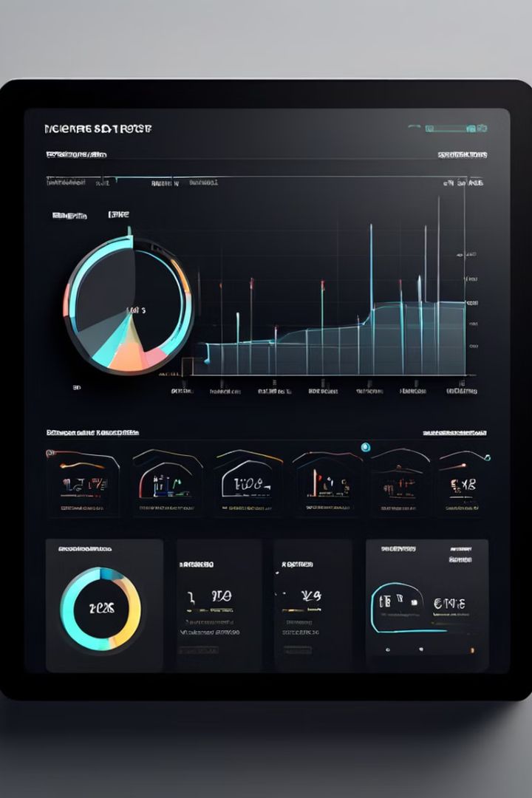
Web Interface Development
Flask Web Server
Interactive Charts
Raspberry Pi runs a Flask application to serve the web interface
Visualize sensor data trends using JavaScript charting libraries
Mobile Responsive
Authentication
Ensure the web interface is accessible on any device
Add user authentication to secure the monitoring dashboard

Slide 6



AWS EC2 Integration
Global Access
Centralized Management
Deploy the web interface on an AWS EC2 instance for worldwide visibility
AWS Console provides a unified view for monitoring and administration

Slide 7
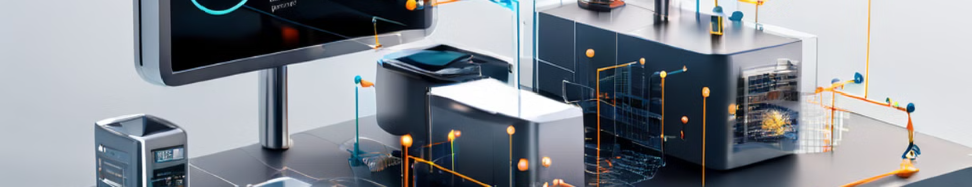



Deployment and Monitoring
Deployment
Monitoring
Maintenance
Install and configure all hardware and software components
Track system health, data integrity, and user activity
Perform regular updates and address any issues that arise

Slide 8

Conclusion and Future Enhancements
1
Scalable Architecture
2
Actionable Insights
Designed to handle increasing sensor data and user demands
Empower users to make informed decisions based on data
3
Continuous Improvement
4
Secure and Reliable
Leverage industry best practices for IoT system security and stability
Explore adding new sensors, analytics, and mobile integration

